Slide 1

Advanced Mechanics
(Lecture 10)
ANNOUNCE / BUSINESS
HW 4 (due TODAY)
HW 5 (due next week)
NEW STUFF
Fatigue (can still be quasi-static)
Dynamic loading
Impact

Slide 2
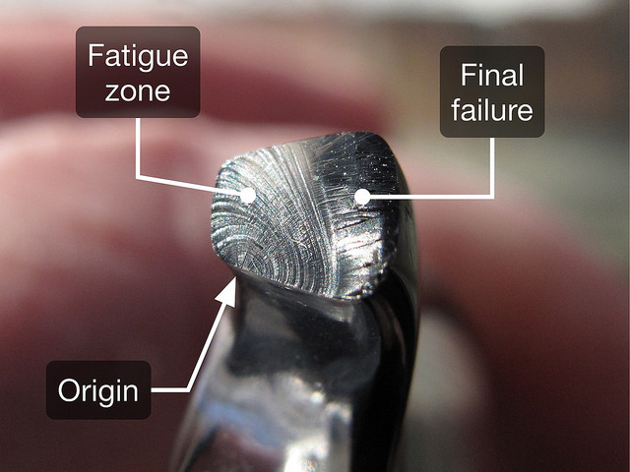
Fatigue
Repeated loading (also “fluctuating” or “alternating” stresses) below ultimate, and even yield, strength may result in reduced strength (and ductility)
Important factors: stress, structural discontinuities, quality of surface finish, chemical nature of environment
Nature of fracture in ductile metals in fatigue loading is different from that in static loading
Failure surface shows two zones of failure
“beach marks” due to gradual crack development
sudden fracture
http://www.leancrew.com/all-this/2014/01/bridge-failure/

Slide 3

Fatigue
Repeated loading (also “fluctuating” or “alternating” stresses) below ultimate, and even yield, strength may result in reduced strength (and ductility)
Important factors: stress, structural discontinuities, quality of surface finish, chemical nature of environment
Types of fracture in ductile metals in fatigue loading are different from those in static loading
Failure surface shows two zones of failure
“beach marks” due to gradual crack development
sudden fracture
http://www.leancrew.com/all-this/2014/01/bridge-failure/

Slide 4
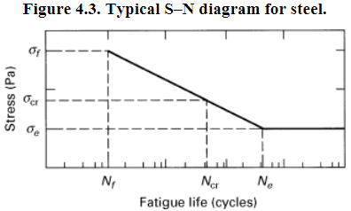
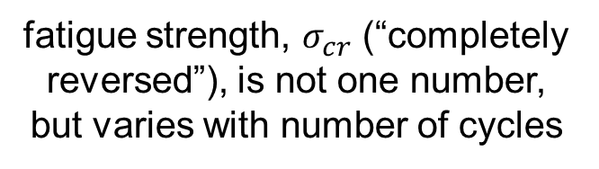
Fatigue = Progressive Fracture
Origin of fatigue failure is typically a crack … “progressive fracture” is more accurate mechanistic description than “fatigue” (in my opinion! ☺)
Compressive stress believed to not contribute to crack growth
Fatigue life / strength: number of stress cycles to fracture
experimentally defined; reported with S-N diagram
fatigue strength, $σ_{cr}$ (“completely reversed”), is not one number, but varies with number of cycles
fatigue, or endurance, limit

Slide 5
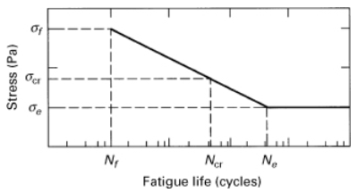


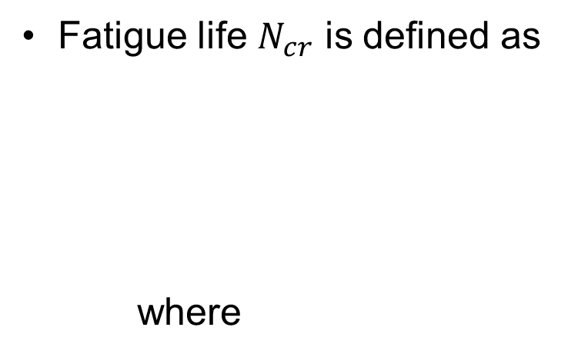
Fatigue
Every material has a unique S-N curve
Fatigue life $N_{cr}$ is defined as
where
$$N_{cr}=N_{f}{\left(\frac{σ_{cr}}{σ_{f}}\right)}^{1/b}$$
$$b=\frac{ln⁡(σ_{f}/σ_{e})}{ln⁡(N_{f}/N_{e})}$$

Slide 6
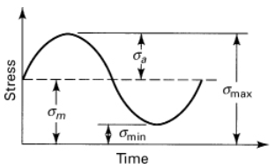

Fatigue – Mean Stress
Common to have alternating sinusoidal stress imposed on a uniform, or mean, stress
May be due to vibration imposed on a part under stress
Alternating stress is most important to failure, especially if mean stress is negative, but still need to account for both

Slide 7
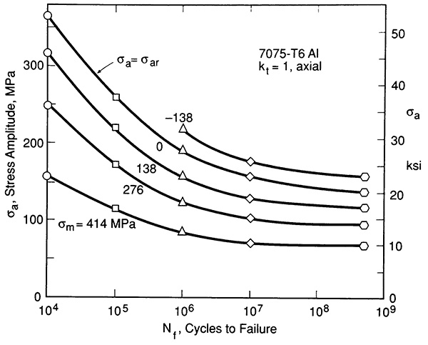

Fatigue Life
Mean stress influences S-N behavior
$${(σ}_{cr})$$
(Dowling, Fig 9.25)

Slide 8
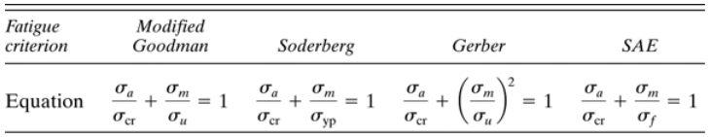
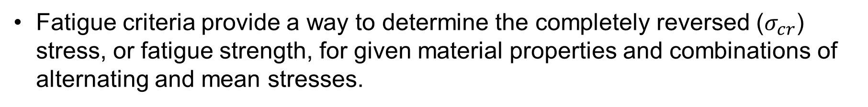
Fatigue Failure Criteria
Fatigue criteria provide a way to determine the completely reversed ($σ_{cr}$) stress, or fatigue strength, for given material properties and combinations of alternating and mean stresses.
(not as conservative)
(equivalent to Modified Goodman for brittle materials)
good for steel
Notes:
We see that each equation relates the applied mean and alternating stresses to a completely reversed alternating stress and a failure strength parameter

Slide 9
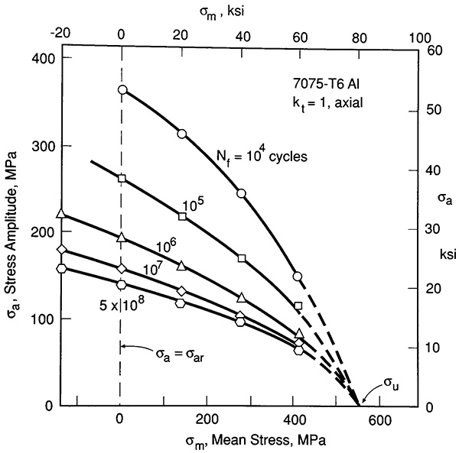
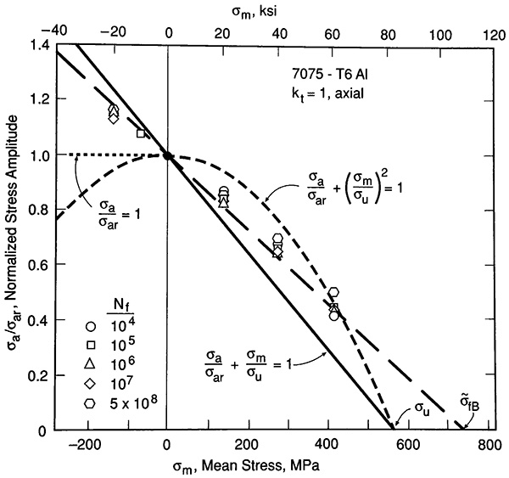
Fatigue Life
To make sense of these relationships, plot $σ_{a}$ v. $σ_{m}$ (constant life diagram)
(Dowling, Figs 9.34, 9.36)

Slide 10



Fatigue
Once we know the fatigue strength for a given loading combination …
we can determine the number of cycles to failure
$$\frac{σ_{a}}{σ_{cr}}+\frac{σ_{m}}{σ_{u}}=1$$

Slide 11
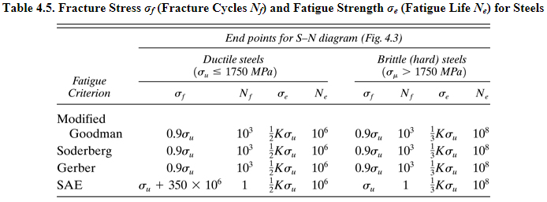
Fatigue

Slide 12

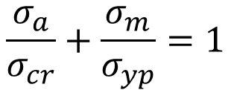
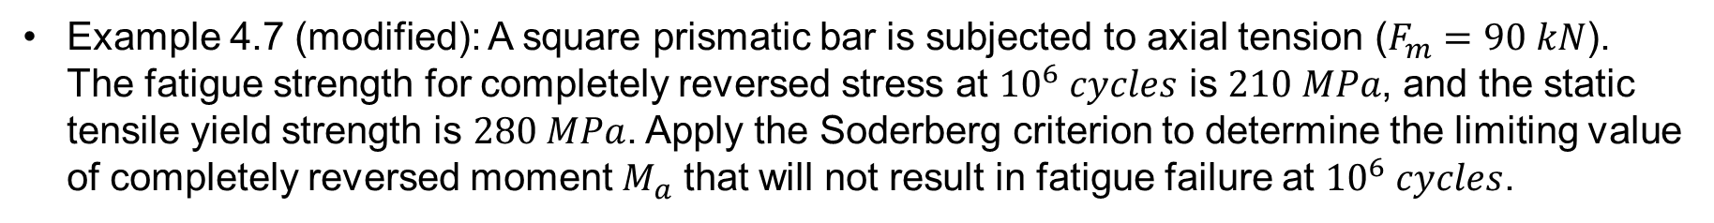
Example
Example 4.7 (modified): A square prismatic bar is subjected to axial tension ($F_{m}=90 kN$). The fatigue strength for completely reversed stress at ${10}^{6} cycles$ is $210 MPa$, and the static tensile yield strength is $280 MPa$. Apply the Soderberg criterion to determine the limiting value of completely reversed moment $M_{a}$ that will not result in fatigue failure at ${10}^{6} cycles$.
$$\frac{σ_{a}}{σ_{cr}}+\frac{σ_{m}}{σ_{yp}}=1$$
$$M_{a}$$
* Note that although mean and alternating stresses were caused by different modes of loading here, this is not generally the case

Slide 13
Fatigue Failure Criteria – Combined Loads
What about when repeated stress at a location includes contributions from multiple modes of loading?
Use static failure theory approach to find “effective” alternating and mean stress values, e.g., using distortion energy,
Then use these effective stresses in fatigue failure criteria.
Note that the validity of this approach is questionable for loading scenarios where the principal stress directions change as part of the loading. The book says nothing about this limitation, but this is beyond the scope of our class.

Slide 14
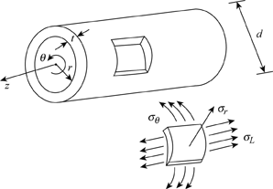
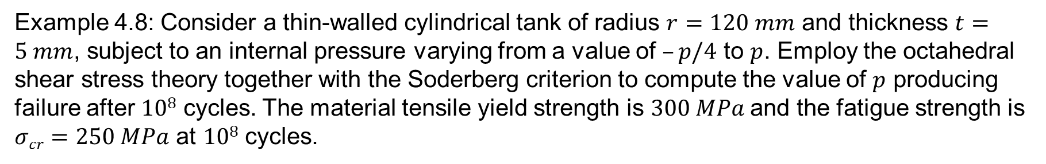
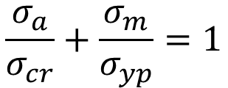
Example
Example 4.8: Consider a thin-walled cylindrical tank of radius $r=120 mm$ and thickness $t=5 mm$, subject to an internal pressure varying from a value of $–p/4$ to $p$. Employ the octahedral shear stress theory together with the Soderberg criterion to compute the value of $p$ producing failure after $108$ cycles. The material tensile yield strength is $300 MPa$and the fatigue strength is $σcr=250 MPa$ at $108$ cycles.
$$\frac{σ_{a}}{σ_{cr}}+\frac{σ_{m}}{σ_{yp}}=1$$

Slide 16

Impact / Dynamic Loading

Slide 17

Notes:
This rigging company is in West Valley City!

Slide 18
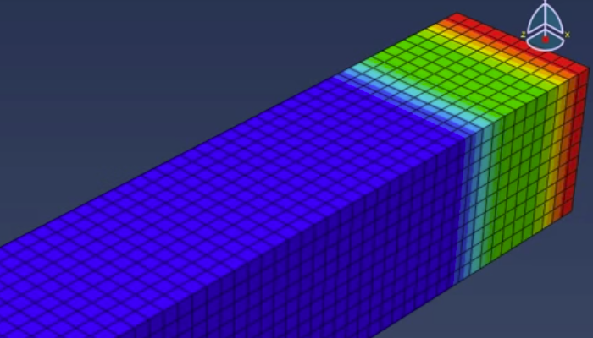
Impact / Dynamic Loading
Forces suddenly applied to parts / structures
Shock or impact loading occur when time of load application is equal to or smaller than largest natural period of vibration of the structure – stress waves are significant

